Slide 1
Baseball Statistics
By Brian Bargas, German Martinez, Chris Pena

Slide 2
DATA

Slide 3
Source
Sean Lahman Online Baseball Database
1871 to 2014
Several different baseball stats including;
Plus Fielding Statistics
Standings
Team Stats
Managerial Records
Post-Season Data
Salary
Pitching
Bating
Player Personal Info

Slide 4
Summary

Slide 5
ETL

Slide 6
Tableu Visualizations

Slide 7
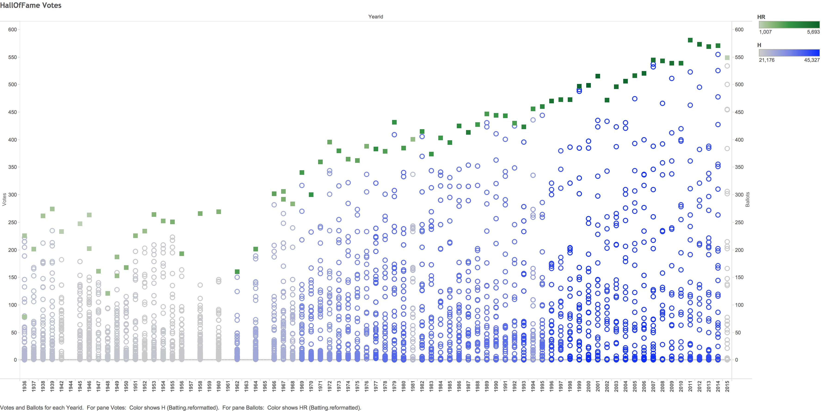
Hall of Fame Votes

Slide 8
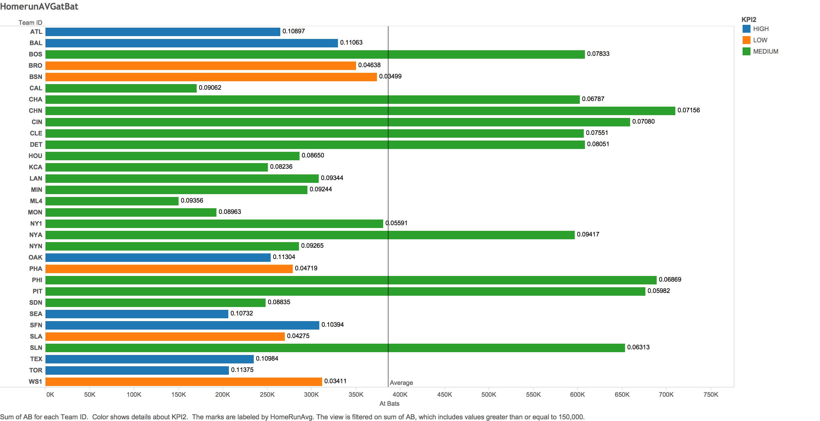
Homeruns Average at Bat

Slide 9
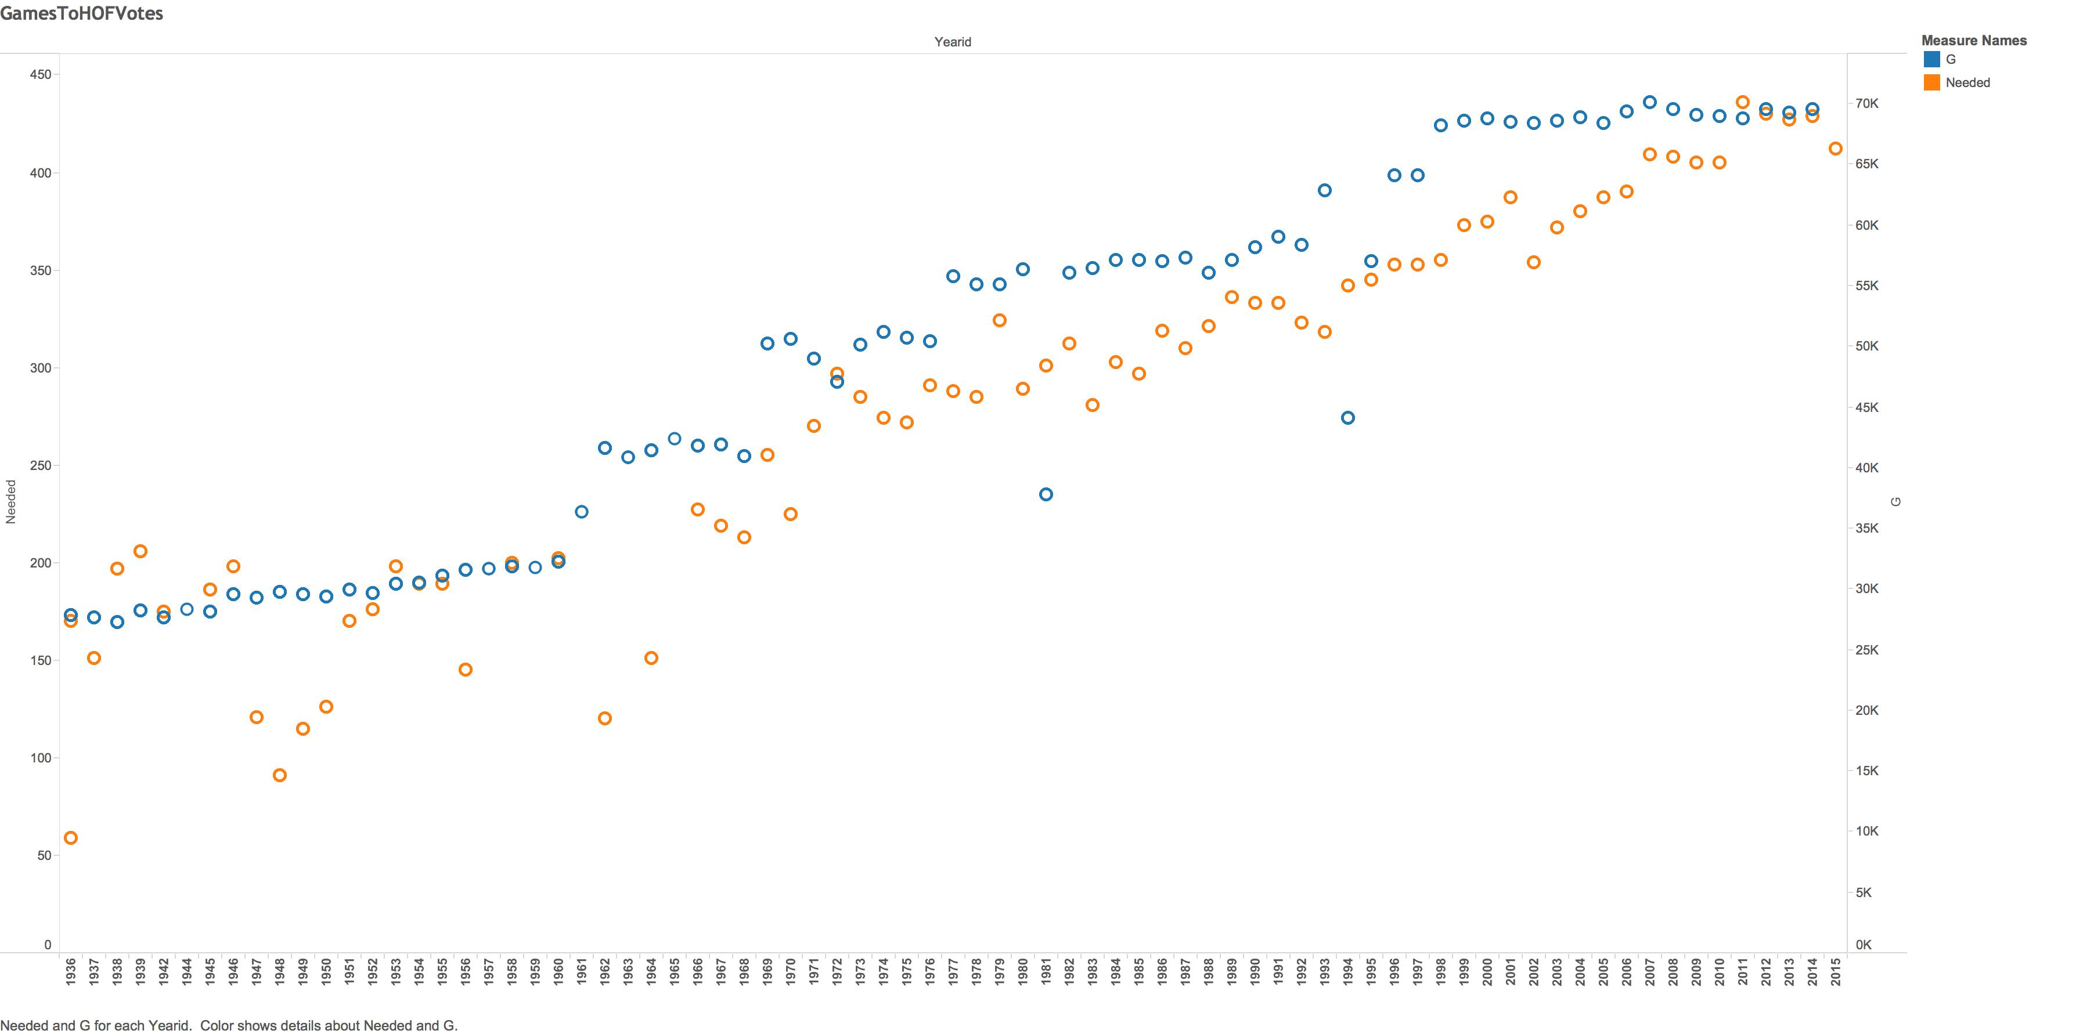
Number of Games vs Hall of Fame Votes

Slide 10
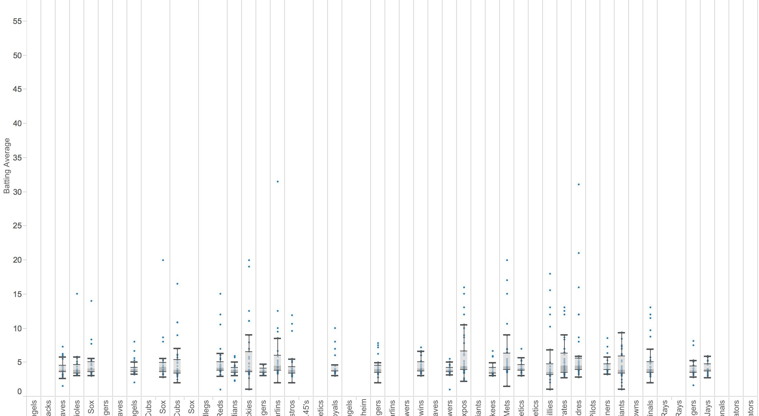
Team Batting Averages

Slide 11
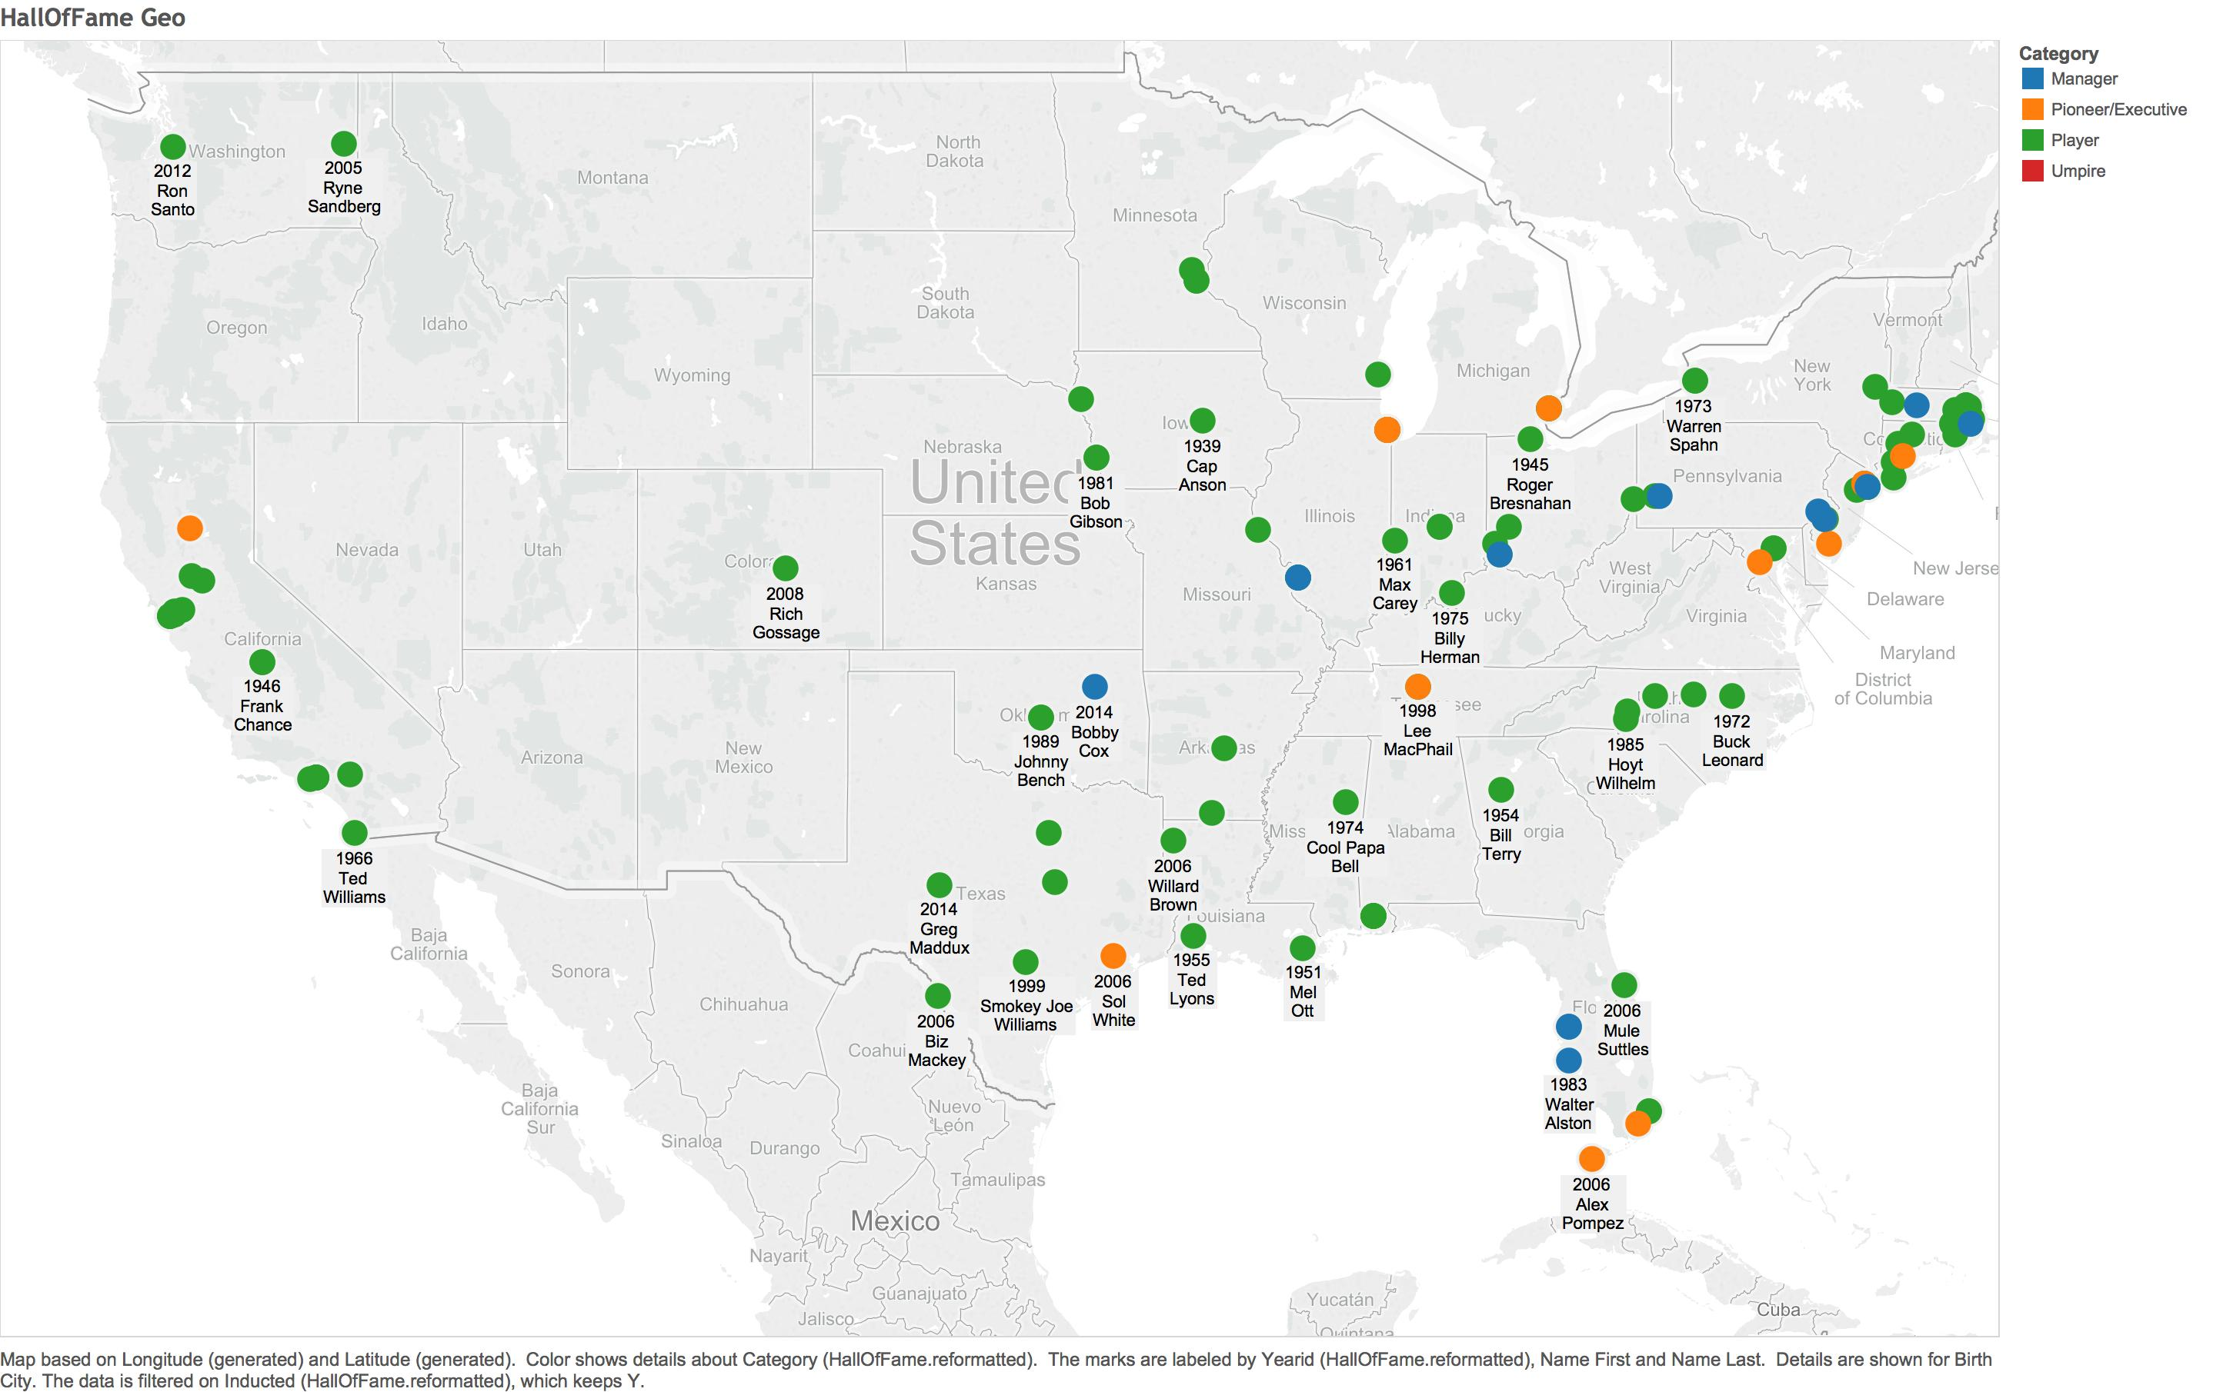
Hall of Fame by City

Slide 12
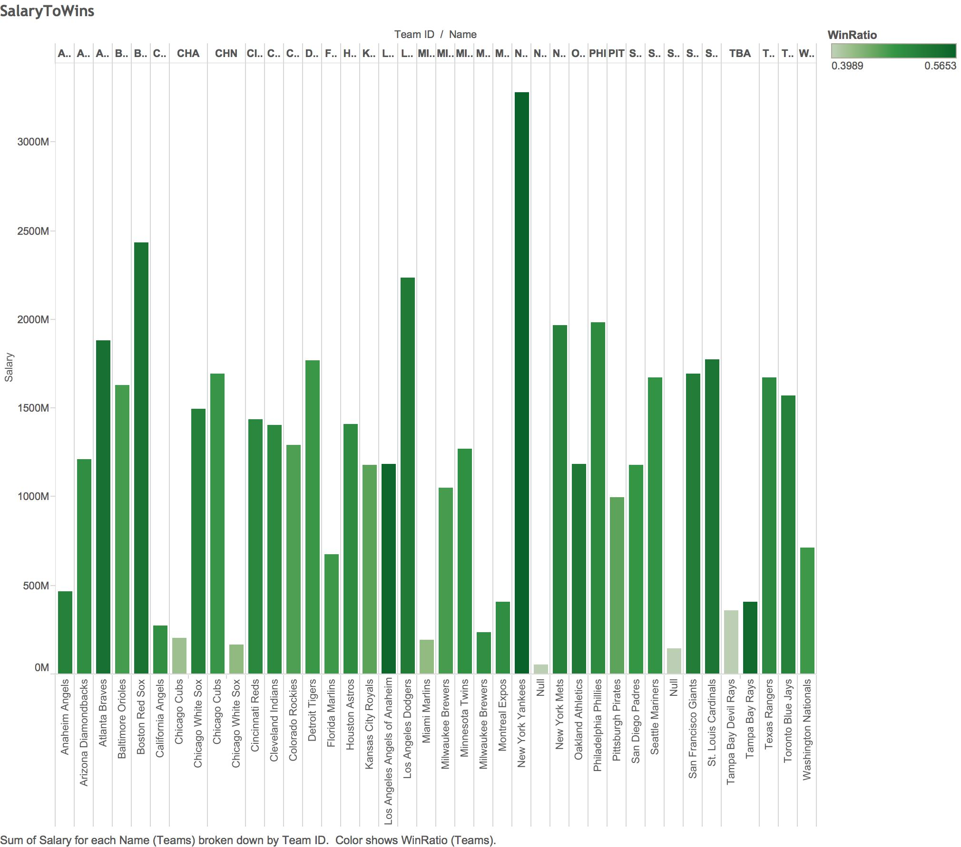
Salary to Wins

Slide 13
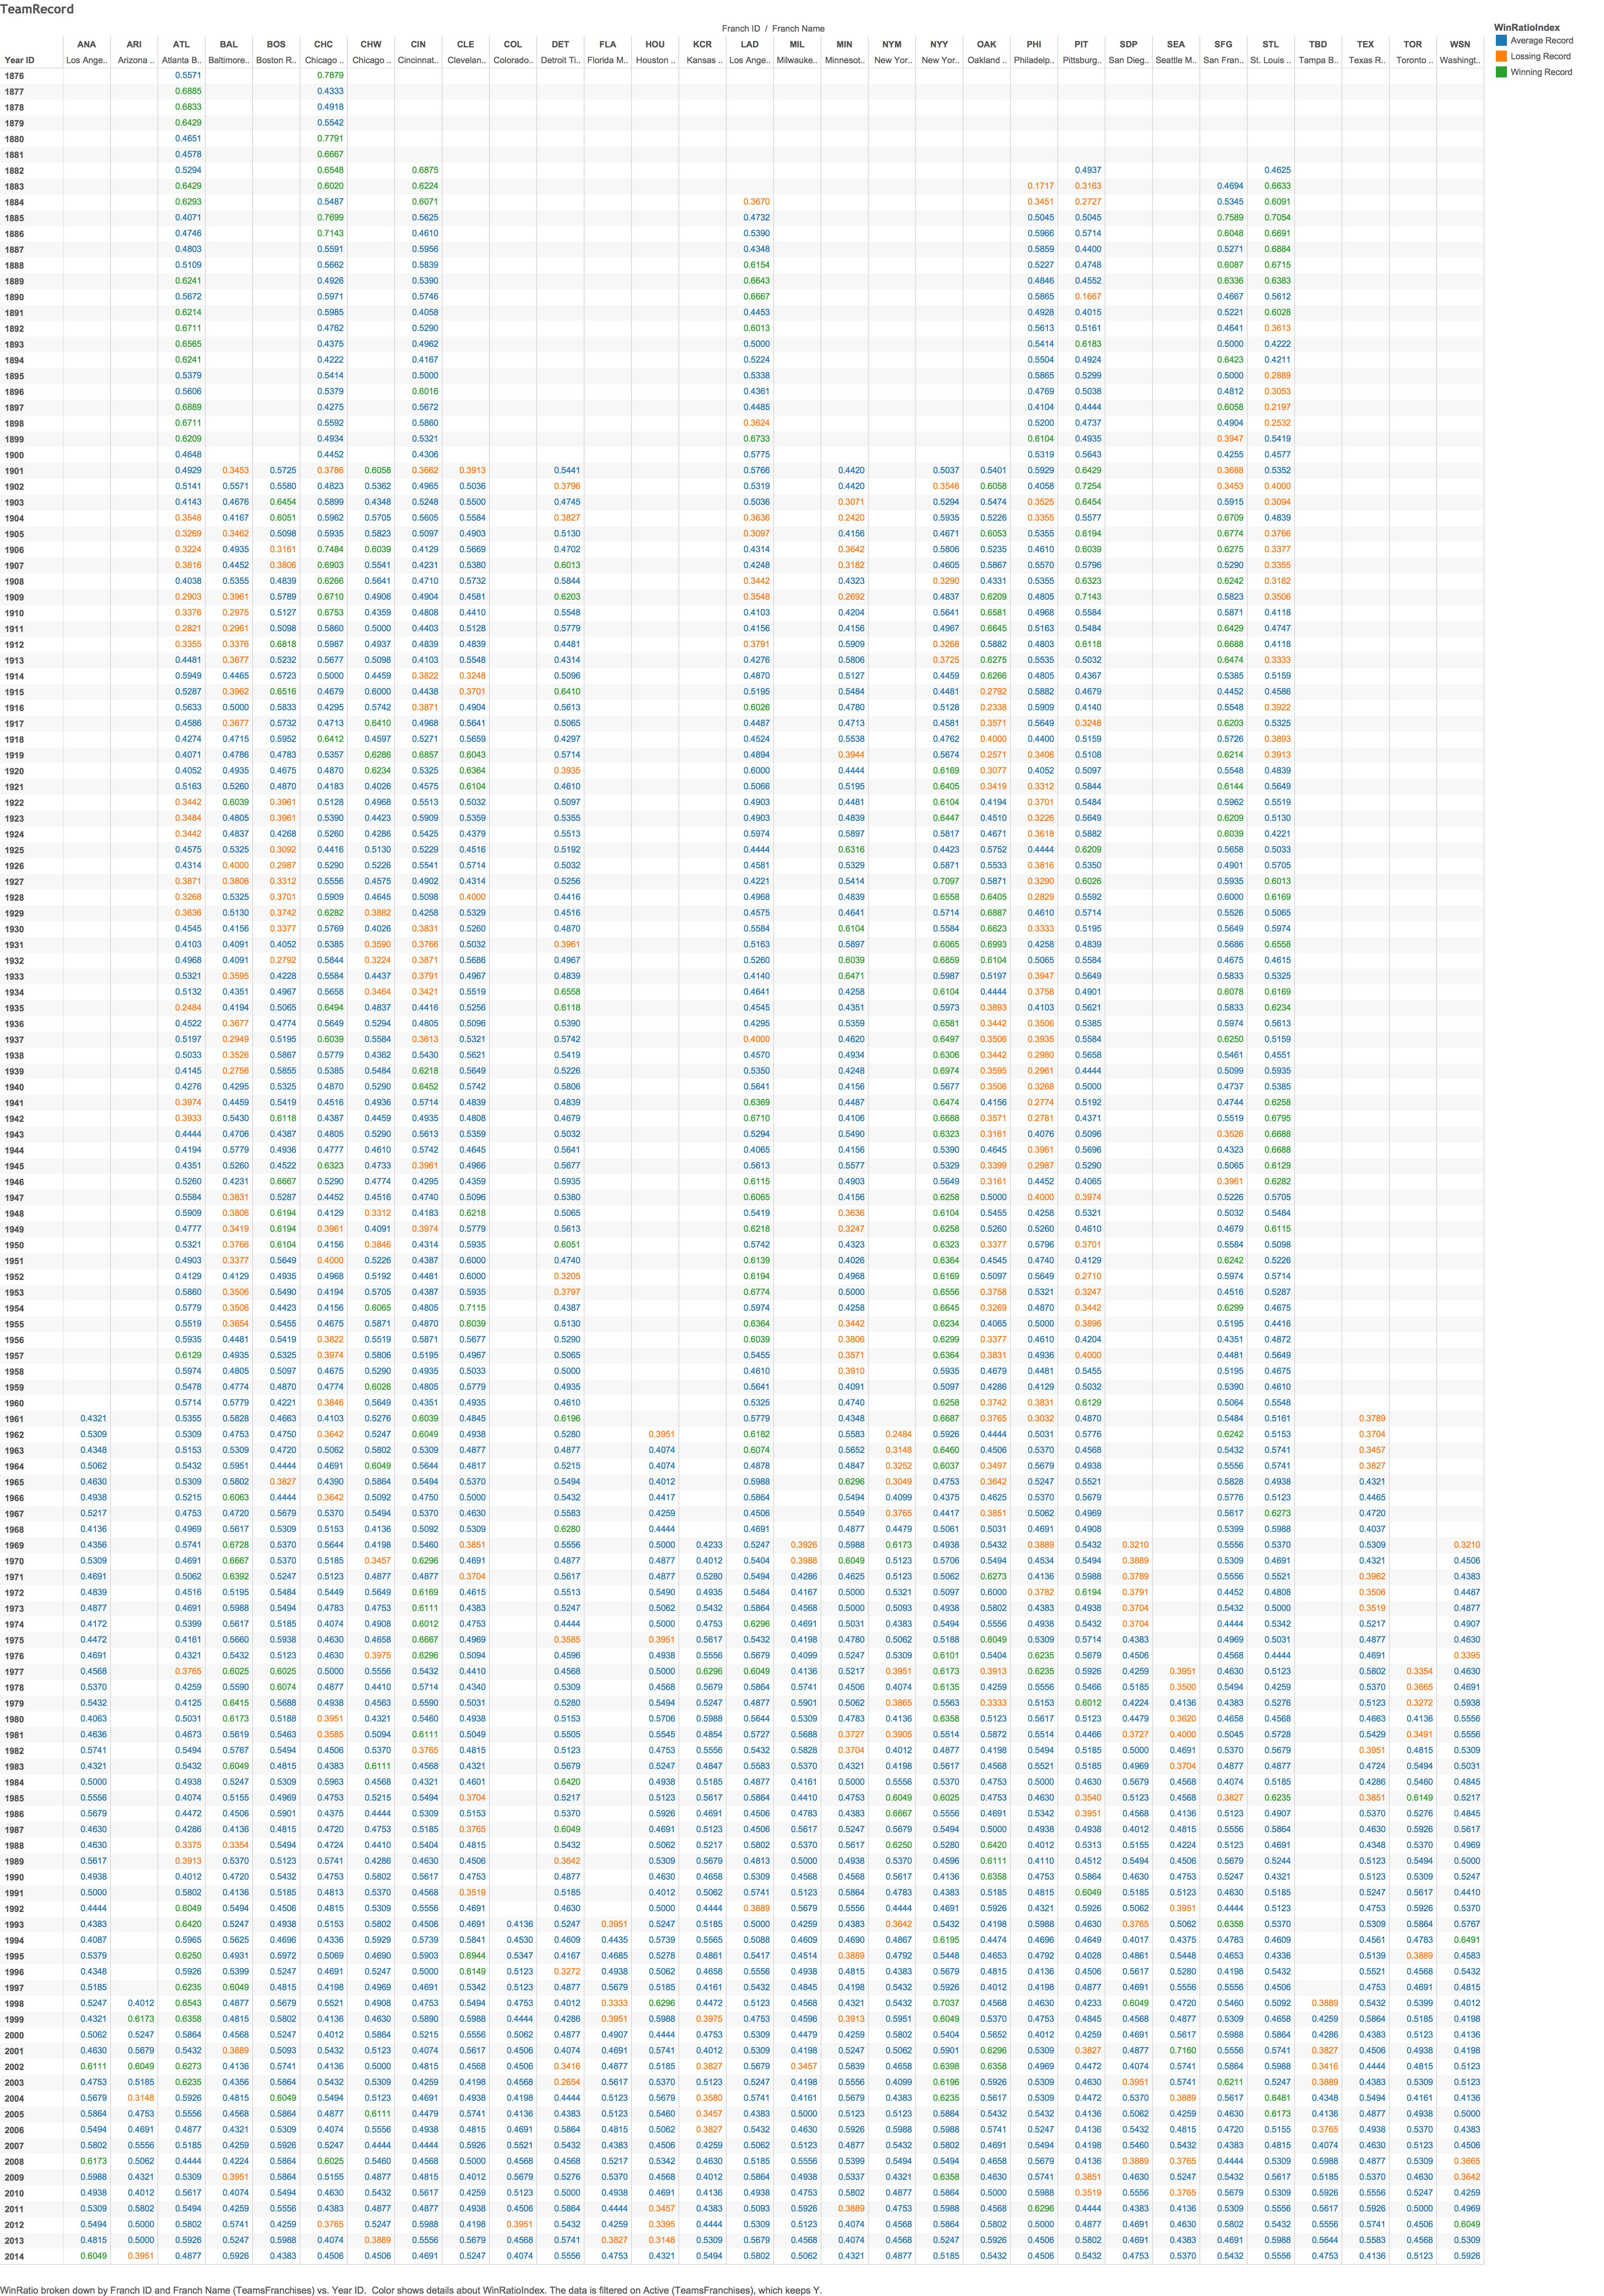
Team Records

Slide 14
Shiny

Slide 15
Server

Slide 16
R

Slide 17
Link

Slide 18
Questions, Comments, Complements?

